Slide 1
Dice Black Jack
Af Martin & Mike

Slide 2
Opbygning
Game
Player
Machine
Compare
Dice
Statestik

Slide 3
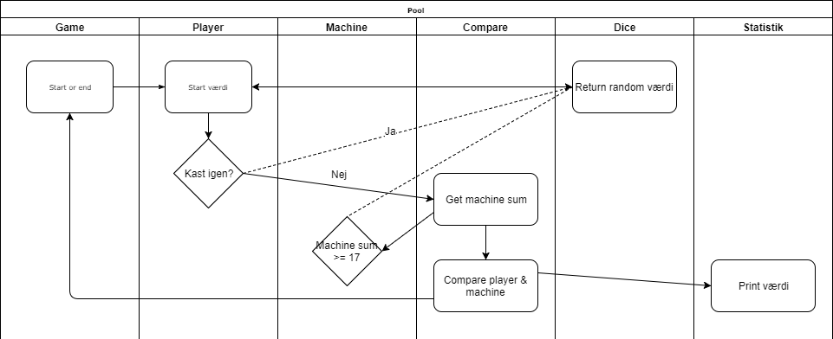
Flow chart

Slide 4
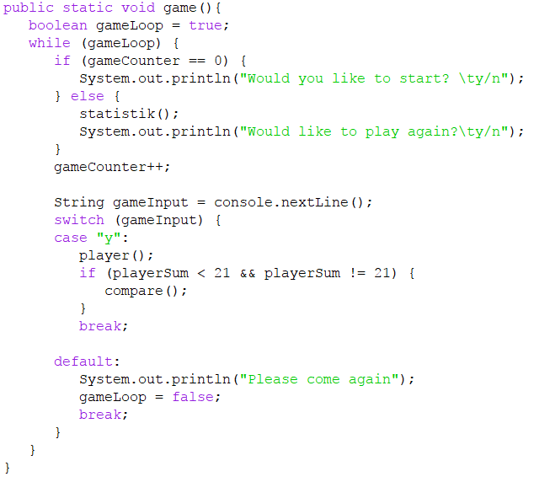
Game

Slide 5

Dice

Slide 6
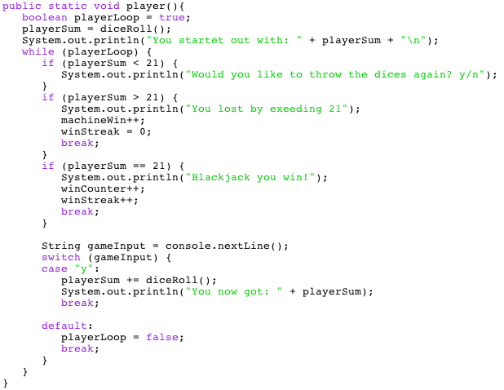
Player

Slide 7
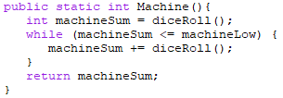
Machine

Slide 8
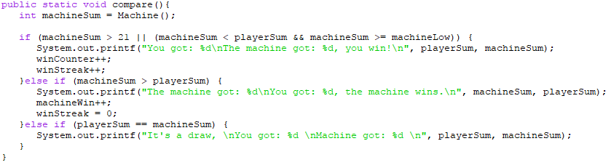
Compare

Slide 9
Statistik

